Slide 1

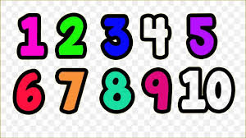
FOUNDATION PHASE MATHEMATICS WORKSHOP PRESENTATION

Slide 2
Objectives of Term Two workshop
Understanding numbers
Recognition of numbers
Understanding place value

Slide 3
What is a number?
A number is a basic unit of mathematics.
Numbers are used for counting, measuring, and comparing amounts.
The most common number system uses 10 symbols called digits – 0, 1, 2, 3, 4, 5, 6, 7, 8 and 9 – and combination of these digits.
We write or talk about numbers using numerals such as "4" or "four".
But we could also hold up 4 fingers, or tap the ground 4 times.
These are all different ways of referring to the same number.

Slide 4
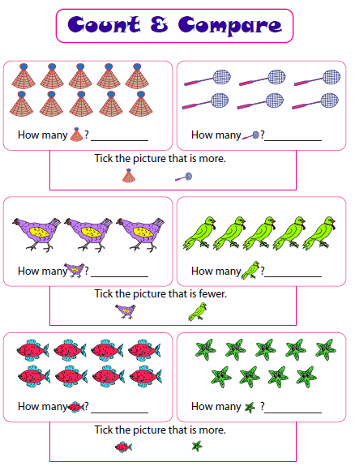
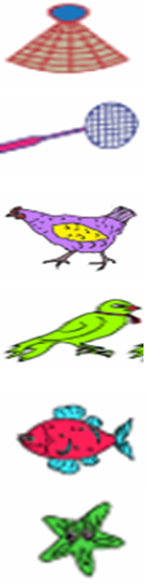
Objects | Number Symbol | Number Name

Slide 5
Number representation
Numbers could be represented in different forms.
Expanded form or expanded notation is a way of writing numbers to see the mathematics value of an individual digit in a number.
325 in expanded notation form is + 300 + 20 + 5 = 325.
This is also called breaking down and building up of numbers.

Slide 6
BREAKING DOWN AND BUILDING UP NUMBERS
Complete the following activities by breaking down the numbers in the correct column
Grade One and Two
Grade Three
Numbers
13
45
59
62
79
83
97
Tens | Units
1 | 3
Numbers
148
273
381
452
596
725
819
Hundreds | Tens | Units
1 | 4 | 8

Slide 7
Breaking down (expanded notation) and building up of numbers
Complete the activity by breaking down and building up the numbers as show in the examples below
Numbers
13
45
59
62
79
83
97
Breaking down or expanded notation
10 + 3 = 13
Numbers
148
273
381
452
596
725
819
Breading down or expanded notation
100 + 40 + 8 = 148

Slide 8
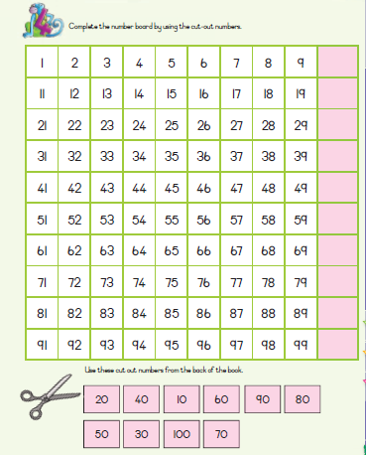
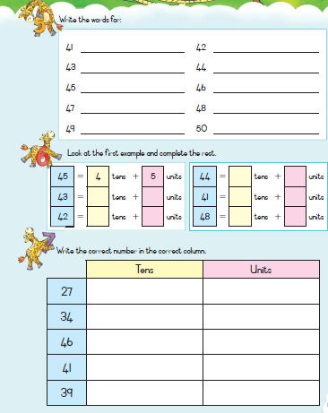
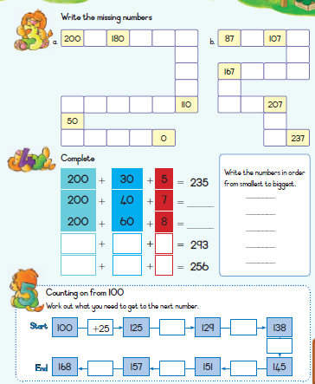
PRACTICE ACTIVITIES FROM THE WORKBOOKS
Grade One workbook page 125
Grade Two workbook page 73
Grade Three workbook page 77

Slide 9
Why are numbers important in our lives?
Lulondwe’s story
I am a girl. My name is Lulondwe Mthethwa. I am 3 years old. I live at Kwa Mashu. The house number of my home is D1302. The name of my mother is Thule Mthethwa. She is taking care of everyone at home. We are a family of 5, mom, dad, my aunt, my sister, and myself.
How old will Lulondwe be in her next birthday?
How many family members does she have in her home?
Where does she stay?

Slide 10
CONCLUSION
What learners need to know about numbers?
Number symbols and number names.
Counting and representing objects in numbers symbols and number names.
Representation of numbers using digits.
Identify the value of a digit in a number using place value.
Counting forward and backwards in different intervals.
Breaking down (expanded notation) and building up of numbers.

Slide 11
Thank you

